Slide 1

DATA-DRIVEN INSIGHTS FOR BUSINESS OPTIMIZATION: ANALYZING THE CLASSIC MODELS DATASET
Group Members:
Laxmi Prasanna Podhem
Baanu Vasundhara Tumma
Vishnu Uday Pavan
Mahvish Kounain
Mounika Ravella

Slide 2
INTRODUCING THE CLASSIC MODELS DATASET
What It Represents
Key Data Points
The Classic Models dataset represents the operations of a global company specializing in the production and distribution of high-quality scale models of classic cars, motorcycles, ships, and planes. This dataset offers a detailed view of a real-world business environment.
The dataset contains product details, customer information, order processing, employee management, and financial transactions. These details provide valuable insights into product performance, customer behavior, sales trends, and financial performance.

Slide 3
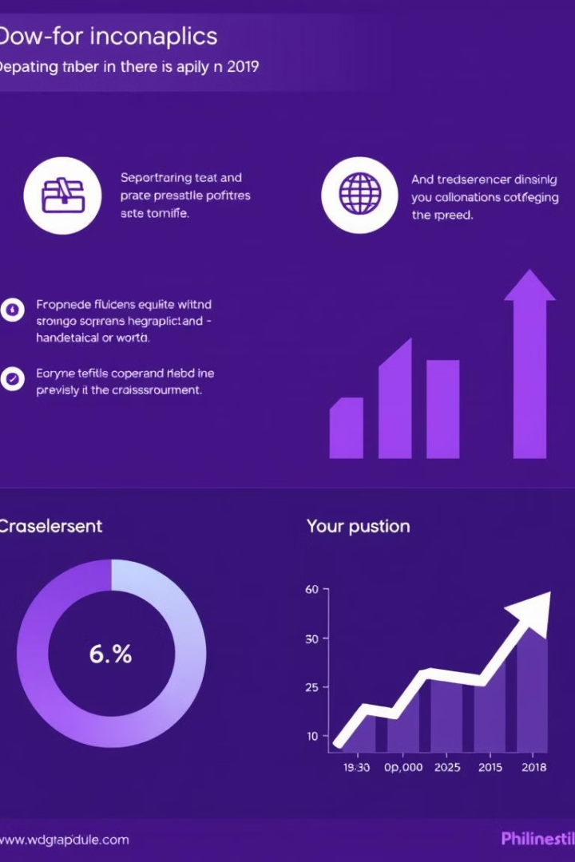
KEY FEATURES FOR ANALYSIS
1
Product Line
2
Sales and Revenue
Categorizes products into lines like Classic Cars, Motorcycles, and Planes. Helps understand each category's revenue contribution.
Includes total sales, average sales per order, and sales count. These metrics help identify high and low-performing product lines and understand profitability.
3
Temporal Data
4
Geographic Sales Data
Provides data on the year and month of sales, enabling analysis of yearly sales trends and patterns, and identifying seasonal sales trends.
Shows the country of each customer, facilitating analysis of sales contributions from different regions and identifying high-performing countries.

Slide 4
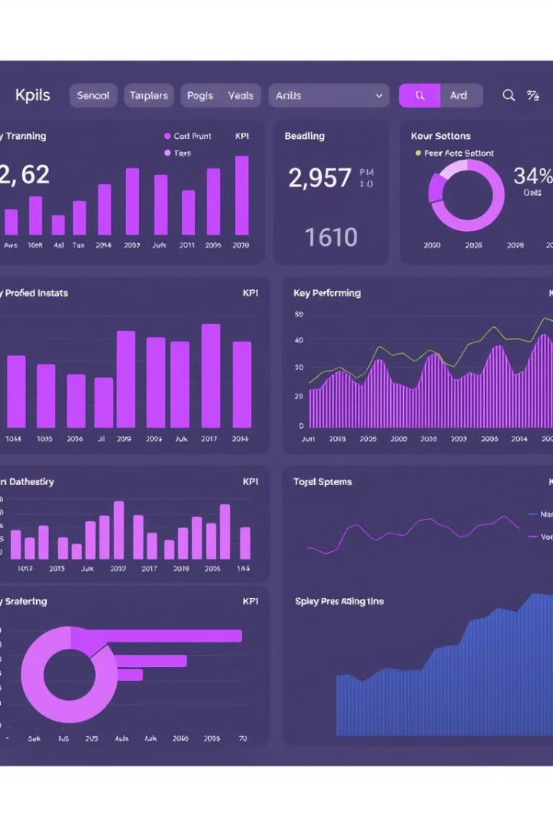
OBJECTIVES
Objective 1
Optimize Product Line Performance: Analyze revenue contributions, identify high and low performers, and develop strategies to improve performance.
Objective 2
Forecast Seasonal Sales Trends: Identify patterns and forecast future sales trends to optimize inventory levels and marketing strategies.
Objective 3
Boost Sales in High-Performing Countries: Analyze sales by country, identify top contributors, and develop targeted marketing strategies.

Slide 5


RESEARCH QUESTIONS
How do different product lines contribute to the overall revenue
of the classic car dealership, and which product lines perform the best and worst?
2. What are the seasonal patterns in sales at the classic car dealership, and how can we forecast future sales trends to optimize inventory and marketing strategies?
3. How do total sales vary across different countries, and what is the linear relationship between the countries and their total sales?

Slide 6
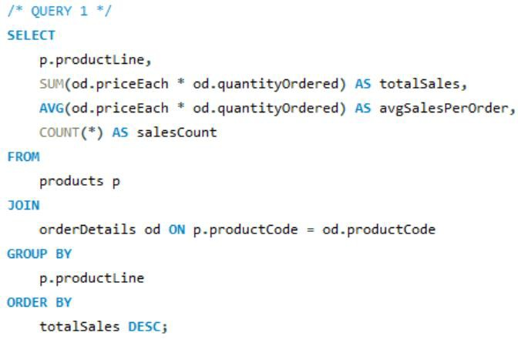
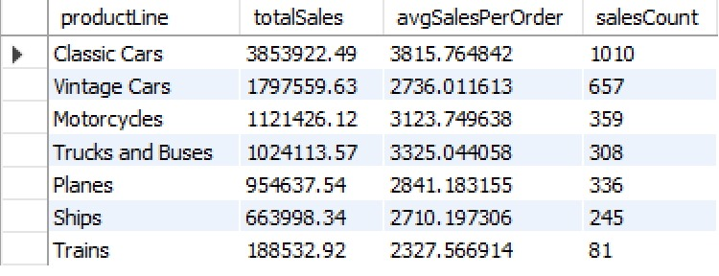
1. PRODUCT LINE CONTRIBUTION TO REVENUE
SQL QUERIES FOR DATA COLLECTION
This query calculates the total revenue, average revenue per order, and the number of sales for each product line. By doing this, it helps identify which product lines are most and least profitable, guiding the dealership to focus on enhancing or discontinuing certain product lines.

Slide 7
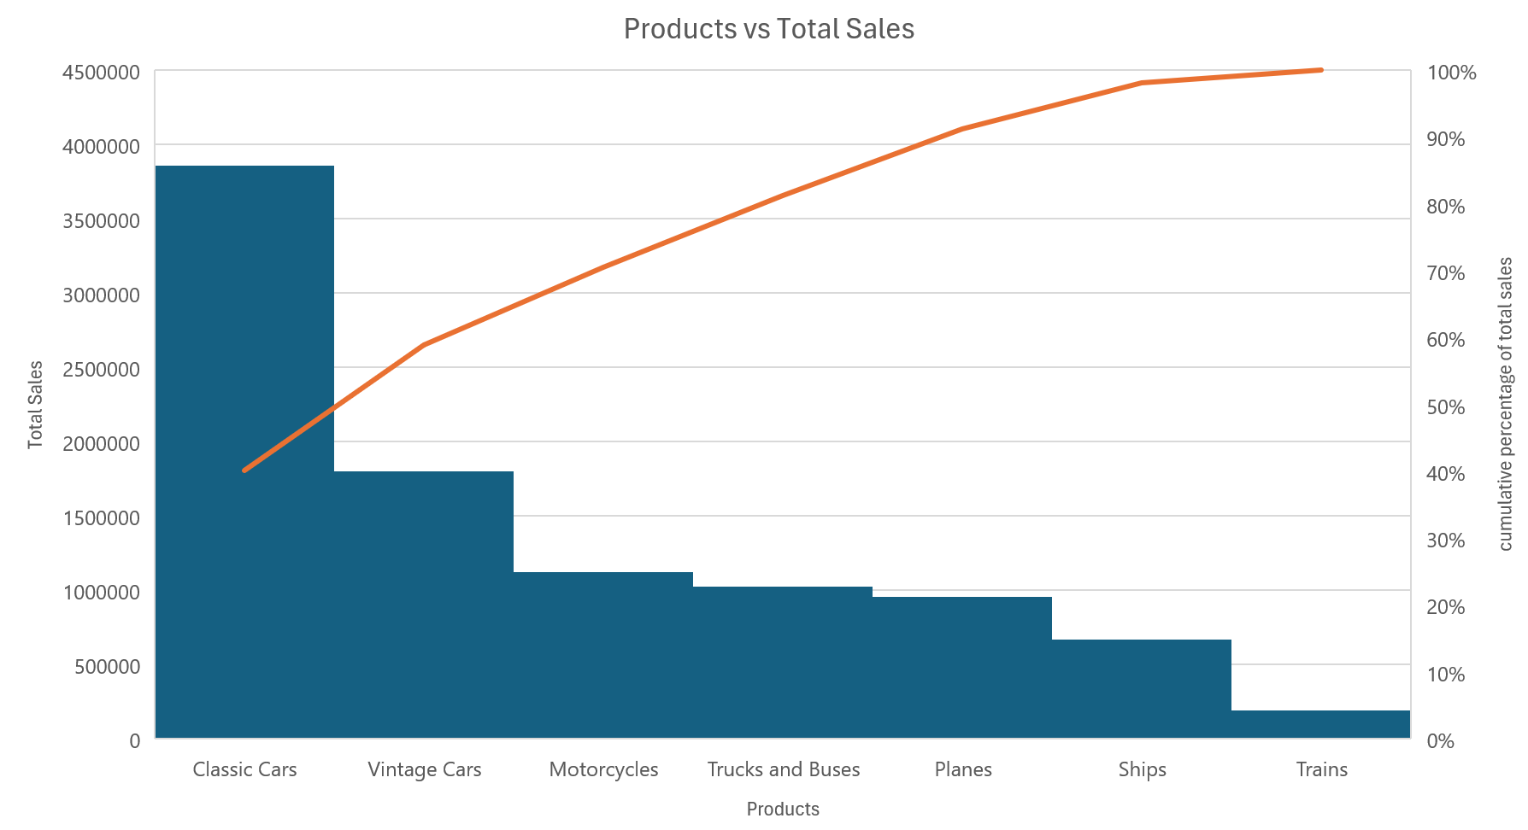
DATA VISUALIZATION
Classic Cars contribute the most to revenue, followed by Vintage Cars, while Planes and Trains generate the least.

Slide 8
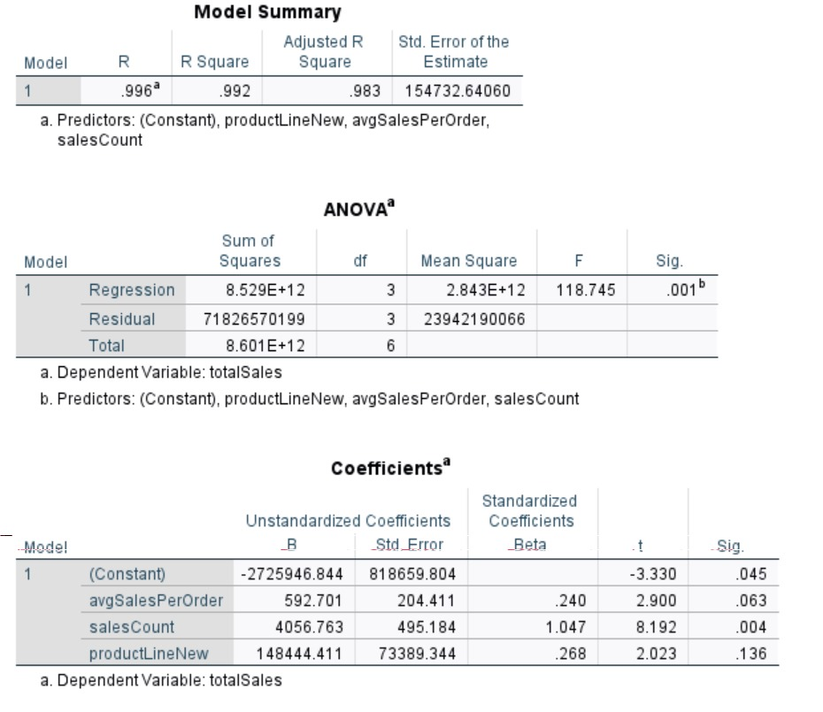
DATA MODELING AND EVALUATION
Null Hypothesis (H0): There is no significant difference in revenue contribution among different product lines.
Alternative Hypothesis (H1): There is a significant difference in revenue contribution among different product lines, with some product lines performing better or worse than others.
The results, obtained through linear regression, support the alternative hypothesis (H1), indicating that there are significant differences in revenue contributions among different product lines.

Slide 9
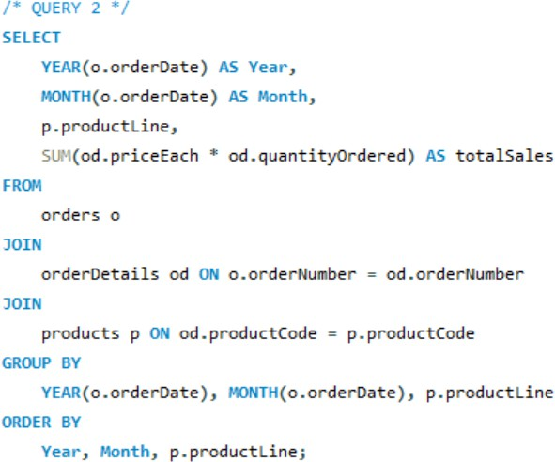
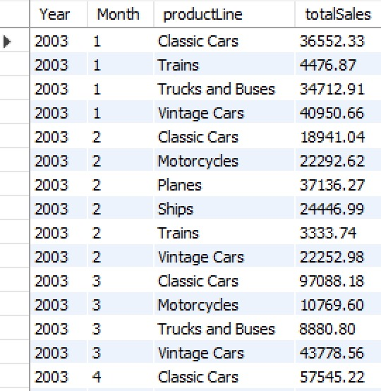
2. SEASONAL SALES PATTERNS
SQL QUERIES FOR DATA COLLECTION
This query summarizes the total sales for each product line by year and month. It reveals seasonal trends, helping the dealership forecast future sales and adjust inventory and marketing strategies to meet demand during peak seasons.

Slide 10
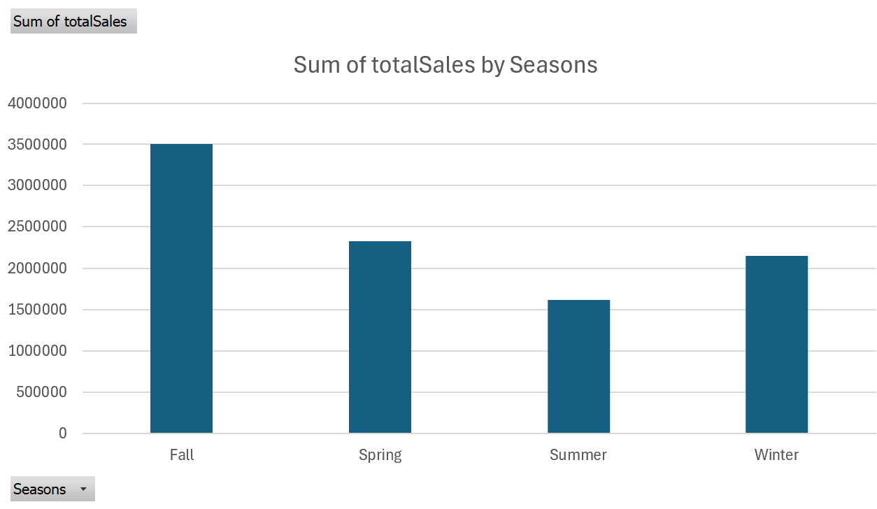
DATA VISUALIZATION
Sales are highest in the Fall, followed by Spring, Winter, and Summer, indicating significant seasonality.

Slide 11
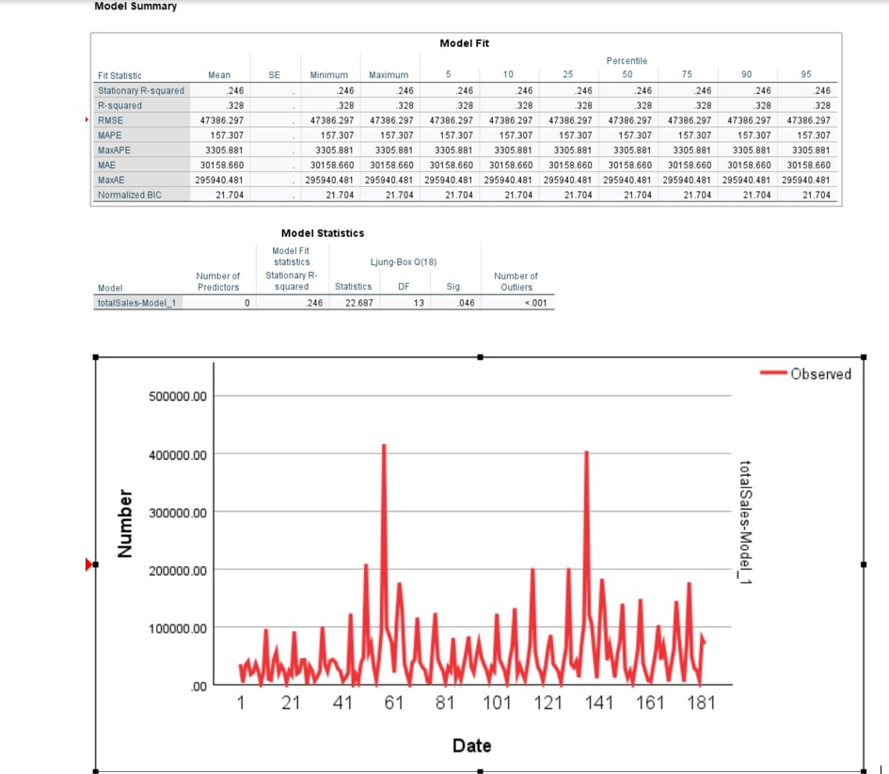
DATA MODELING AND EVALUATION
Null Hypothesis (H0): There are no significant seasonal patterns in the sales data, and it is not possible to forecast future sales trends accurately.
Alternative Hypothesis (H1): There are significant seasonal patterns in the sales data, and it is possible to forecast future sales trends accurately.
This supports the alternative hypothesis (H1) that there are significant seasonal patterns and that future sales trends can be forecasted, although the current model has some limitations.

Slide 12
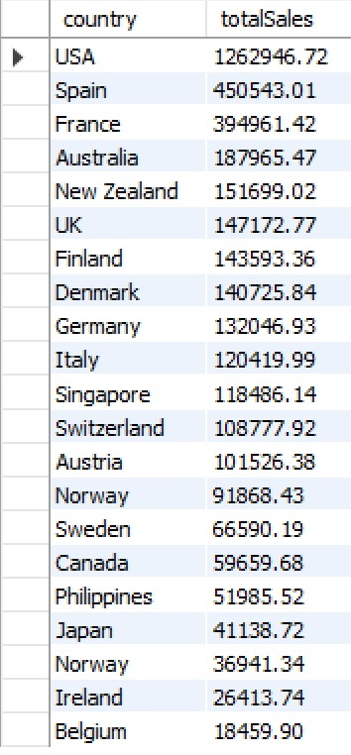
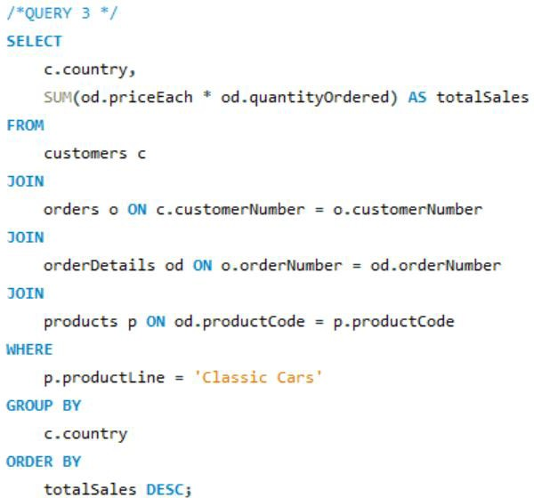
3. SALES VARIATION ACROSS DIFFERENT COUNTRIES:
SQL QUERIES FOR DATA COLLECTION
This query will help you identify the most profitable countries for classic car sales, enabling the dealership to develop targeted marketing strategies and promotions for these high-performing regions to boost overall revenue.

Slide 13
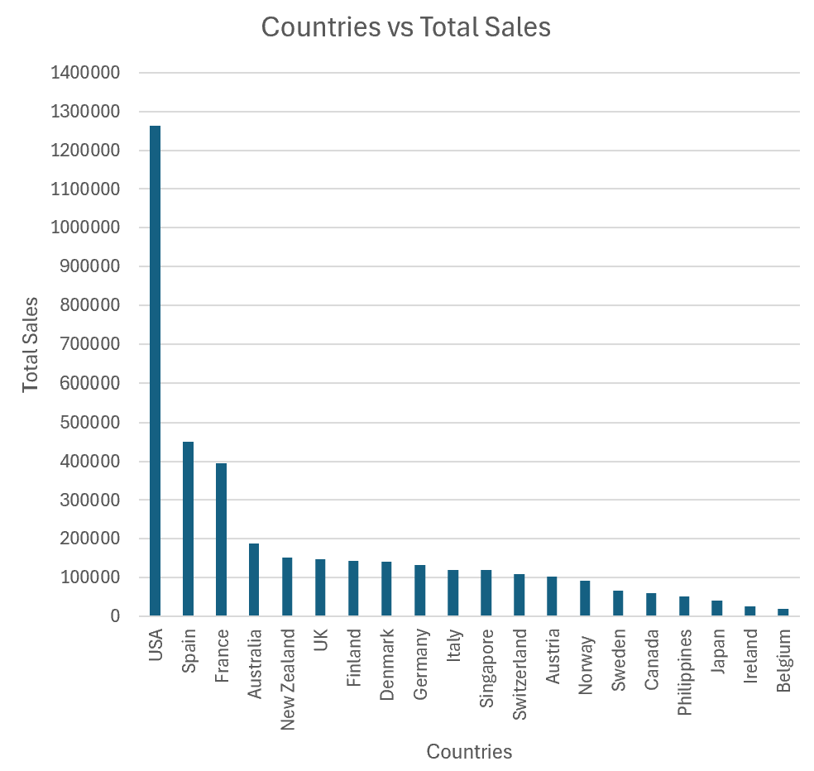
DATA VISUALIZATION
The USA has the highest sales, exceeding 1.2 million units, while Belgium has the lowest.

Slide 14
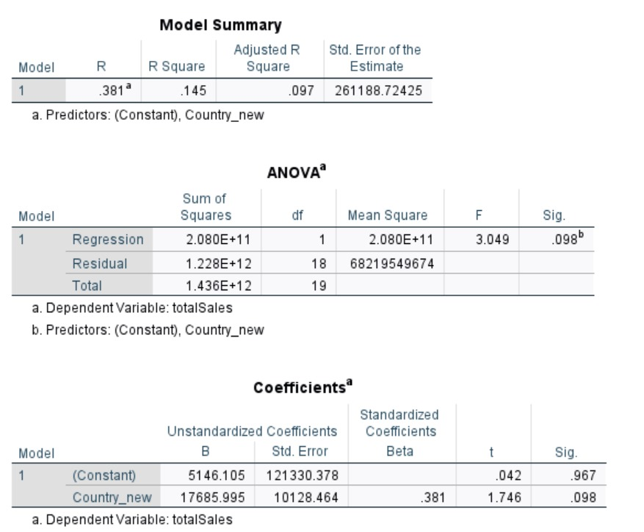
DATA MODELING AND EVALUATION
Null Hypothesis (H0): There is no significant linear relationship between the countries and their total sales.
Alternative Hypothesis (H1): There is a significant linear relationship between the countries and their total sales, indicating that some countries have higher total sales than others.
The linear regression analysis suggests that there is no significant linear relationship between the countries and their total sales. Therefore, we fail to reject the null hypothesis (H0). This means that, based on this test, there is no significant linear relationship between the countries and their total sales.

Slide 15

MARKETING STRATEGIES FOR SUCCESS
1
Product Line Focus
Focus on promoting high-performing product lines and improving the performance of underperforming lines.
2
Seasonal Sales
Leverage seasonal trends with targeted marketing campaigns and optimize inventory management based on demand fluctuations.
3
Country-Specific Strategies
Target high-potential markets and develop localized marketing campaigns to resonate with specific customer preferences.

Slide 16

CONCLUSION AND NEXT STEPS
This presentation has explored data-driven insights from the Classic Models dataset, providing valuable information for business optimization.
By focusing on high-performing product lines, optimizing inventory and marketing strategies for seasonal fluctuations, and considering localized marketing campaigns, Classic Models can achieve significant business growth.
Further exploration of data modeling techniques and the exploration of additional factors influencing sales can offer deeper insights for strategic decision-making.

Slide 17

Thank You !

